Slide 1

Sky130 Usage with Cadence Design System tools
Rachana Erra and James E. Stine, Jr.
VLSI Computer Architecture Research Group
Oklahoma State University
Electrical and Computer Engineering Department
Stillwater, OK 74078 USA

Slide 2
Outline
What is System on Chip (SoC) design
Synthesis
Basics of makefile
Place and Route
Discuss basics of using Innovus (makefile) (diff of combinational vs something that is sequential)
What is a .cmd and a .log file
Importance of Verification (DRC, LVS, PEX)
Maybe slide on files for DRC, PEX
Edge rules
Vertex rules
How did you compile ict file

Slide 3
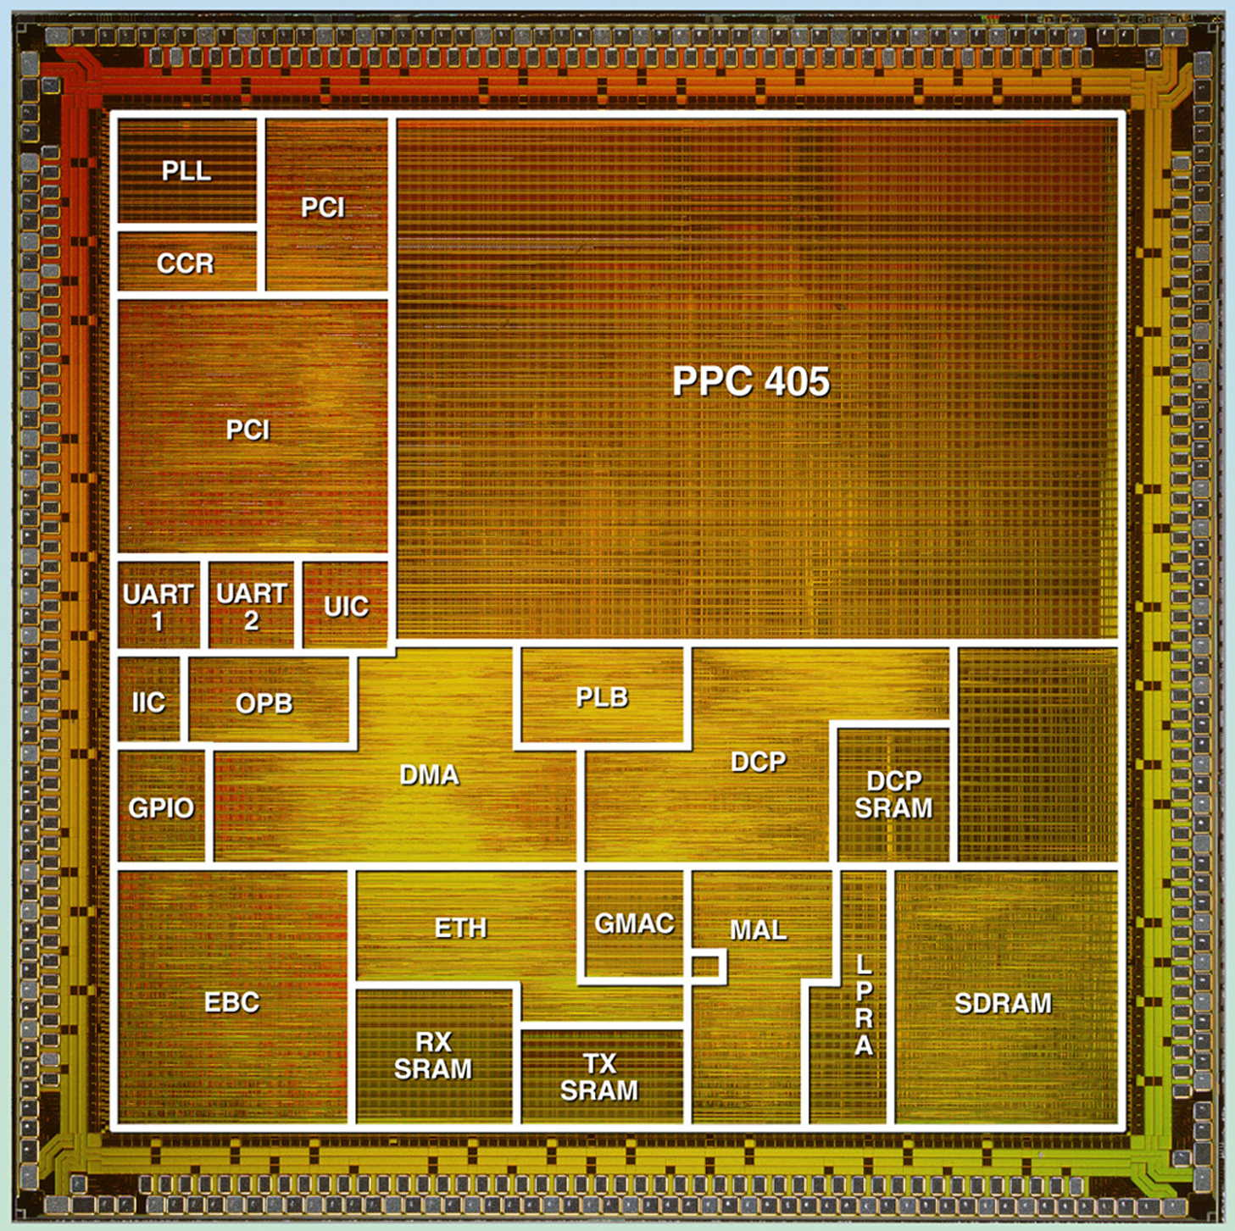
What is SoC?
An SoC contains:
Portable/reusable IP
Embedded CPU
Embedded Memory
Real World Interfaces (USB, PCI, Ethernet)
Software (both on-chip and off)
Mixed-signal Blocks
Programmable HW (FPGAs)
Much more than just standard-cells!

Slide 4
SoC Challenges
Verification goals
functionality, timing, performance, power, physical.
Integrating all elements and still living your life.
Maintaining compliance? (e.g., IEEE 754)
Design complexity
MPUs, MCUs, DSPs, AMS IPs, clock/power distribution, test structures, interface, telecom, multimedia
Business needs!
Time to fix a bug
System
Module
Block
Design integration stage

Slide 5
Challenges
Timing Closure
Sensitive to interconnect delays.
Large Capacity
Hierarchical design and design reuse.
Physical Properties
Signal integrity (crosstalk, IR drop, power/ground bounce)
Design integrity (electron migration, hot electron, wire self-heating)
Fabrication integration and demands (LVS, DRC, DFM)
Managing cost

Slide 6

Validating System-on-Chip by Simulation
Need for both cycle-based and event-driven
asynchronous interfaces
verification of initialization
verification of buses, timing
Need for mixed VHDL/Verilog simulators
IP from various vendors
models in different languages
SoC verification not possible by current simulation tools
Growing gap between amount of verification desired and amount that can be done
Cycle-based
Simulator
Event-driven
Simulator
Abstraction
SPICE
.001x
1x
10x
Performance and Capacity

Slide 7


What is synthesis?
Synthesis is the transformation of an idea into a manufacturable device to carry out an intended function.

Slide 8
What is a compiler?
A compiler is program that translates a source language into an equivalent target language.
This really boils our problem down into a nutshell – code to hardware!

Slide 9
Compilers are complex
text file to abstract syntax
lexing; parsing
abstract syntax to intermediate form (IR)
analysis; optimizations; data layout
IR to machine code
code generation; register allocation
front-end
middle-end
back-end

Slide 10
Problems to address
How to describe language clearly for programmers, precisely for implementors?
How to implement description, and know you’re right?
Automatic conversion of description to implementation
Testing
How to save implementation effort?
Multiple languages to multiple targets: can we re-use effort?
How to make languages usable?
Handle errors reasonably
Detect questionable constructs
Compile quickly

Slide 11
Levels of Abstraction
Idea
Idea captured on
back of envelope
Register Transfer Architectural HDL
Typically, this is what synthesis refers to
Synthesis
Functional Graphical or textual
description
Gate-Level
Netlist
Behavioral
HDL and
simulation language
Physical Device
Silicon

Slide 12
Synthesis
Involves synthesizing a gate netlist from verilog source code
• We use Genus by Cadence which is one of the most popular synthesis tools used in the industry.
Target library examples:
– Standard cell (NAND, NOR, Flip-Flop, etc.)
– FPGA CLB
• Other key files
– source verilog(or VHDL)
– compile script
– output gate netlist
– many reports

Slide 13
HDL Synthesis Guidelines
How do you implement partitioning in the RTL code?
Keep the block sizes reasonable. Remove glue-logic between blocks (move any glue logic into blocks).
Why is it important to partition a design correctly in the source code?
It makes script files easier to write, because the synthesis steps are straightforward (you do not have to worry about repartitioning a design using ungroup and group). The source code is also more representative of the actual design.
What is one reason for not ungrouping the entire hierarchy and compiling a “flattened” design?
One of the partitioning guidelines is to keep block sizes “reasonable”. If you ungroup the entire hierarchy of a top-level design that is large, the compile time may increase significantly.
What are 3 synthesis benefits you gain from good partitioning?
Improved synthesis results, simplified synthesis process, and compile run times are sped up.
List two partitioning guidelines that will help reduce compile run times.
Keep the block sizes reasonable. Remove glue-logic between blocks (move any glue logic into blocks).
Name one partitioning guideline that will help simplify setting constraints on a design.
Partition so that registers drive output ports.

Slide 14
RTL Block Synthesis
Write RTL
HDL Code
Rewrite
No
Simulate
OK?
Yes
Yes
Major
Violations?
No
Synthesize
HDL Code
To Gates
Constraints & Attributes
Area & Timing Goals
No
Met
Constraints?
Analysis
Yes

Slide 15
Makefile
Compiling a source code file can be tedious when you several files and commands.
A makefile is a rule file, containing shell commands, that is created and named makefile (or Makefile depending on the system) that helps automate the process.
Typing make executes all the commands in the makefile.

Slide 16
Example of an average size makefile
CC = gcc
DIR = /user/project/lib
CFLAGS = -g -I$(DIR) -I. -c
LFLAGS = -g
opt: analysis.o flow.o io.o misc.o opt.o opts.o peephole.o regs.o vect.o
$(CC) $(LFLAGS) -o opt analysis.o flow.o io.o misc.o opt.o opts.o peephole.o regs.o vect.o
analysis.o: analysis.c analysis.h $(DIR)/misc.h $(DIR)/opt.h $(DIR)/vect.h
$(CC) $(CFLAGS) analysis.c
flow.o: $(DIR)/flow.c $(DIR)/flow.h $(DIR)/opt.h
$(CC) $(CFLAGS) $(DIR)/flow.c
io.o: $(DIR)/io.c $(DIR)/io.h analysis.h $(DIR)/misc.h $(DIR)/opt.h peephole.h $(DIR)/regs.h
$(CC) $(CFLAGS) $(DIR)/io.c

Slide 17
(cont)
misc.o: $(DIR)/misc.c $(DIR)/misc.h $(DIR)/opt.h
$(CC) $(CFLAGS) $(DIR)/misc.c
opt.o: $(DIR)/opt.c $(DIR)/opt.h
$(CC) $(CFLAGS) $(DIR)/opt.c
opts.o: opts.c $(DIR)/misc.h $(DIR)/regs.h $(DIR)/opt.h opts.h
$(CC) $(CFLAGS) opts.c
peephole.o: peephole.c $(DIR)/misc.h $(DIR)/regs.h $(DIR)/opt.h peephole.h
$(CC) $(CFLAGS) peephole.c
regs.o: $(DIR)/regs.c $(DIR)/regs.h $(DIR)/opt.h
$(CC) $(CFLAGS) $(DIR)/regs.c
vect.o: $(DIR)/vect.c $(DIR)/vect.h $(DIR)/opt.h
$(CC) $(CFLAGS) $(DIR)/vect.c

Slide 18
Other useful Makefile tips
There is a search order related to the ”Makefile” – sometimes this causes problems.
Always include a way to clean up your mess:
make clean
No dependencies!
clean:
/bin/rm –f *.o core
Do NOT forget to include where simple commands are located on the computer you use the Makefile!!! (e.g., /bin or /sbin)

Slide 19
Steps to run synthesis on SKY130 using CDS Genus
cd synth
Add your HDL to hdl subdirectory.
Edit genus script.tcl to load in correct SV files.
Also modify genus_script.tcl to add the timing needed any loading or input/output delays. There are also options for loading that can be changed.
Right now, a FF is assumed to be at the beginning and end of the timing to constrain the timing properly.
Constraint settings are found within the constraints top.sdc file.
make synth
All output is logged to synth.out that should be checked on completion.
Reports are found within the reports directory and any mapped HDL is found in the top directory.

Slide 20
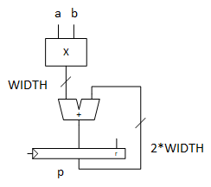
Sample Design
Our sample design is a 16-bit multiplier and adder with a register.
You can use any design to synthesis and place/route for this work.
The HDL can also be modified by adjusting the WIDTH parameter to increase the size of the design.

Slide 21
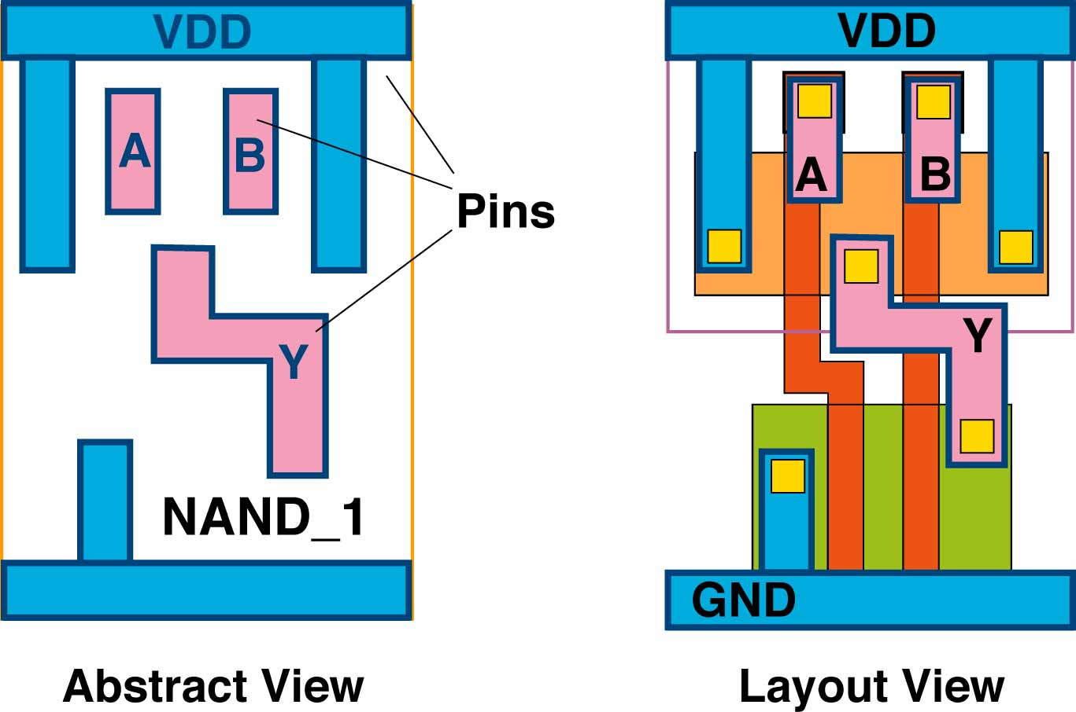
What does PnR do?
module CONTROL ….
input A, B, C;
output reg X;
………..
and2 U1 (.I0(B), .I1(C), .Z(T1);
or2 U2 (.I0(B), .I1(C), .Z(T2);
mux2 U3 (.S(A),.I1(T1),.I2(T2), .Z(X);
………..
PnR
IP
Gate-level Netlist
P&R’d Layout
create_clock –period 10 ……
set_input_delay –max 1.2 ….
set_output_delay –max 2.5 ….
set_load 0.25 …..
……….
Standard Cell Library
Timing Constraints

Slide 22
Place and Route (P&R)
Today, place and route is more than just standard-cells!
It involves memories, IP, processors, pad cells.
The ideas are the same, with some small exceptions, for memories and other items as with standard-cells.
We will differentiate things later as we move forward but will initially start with standard-cell designs.
New chips rely heavily on other IP and ARM has made good use of this area by providing IP that is easily integrated with other items.

Slide 23
Floorplan Initialization
For common bondpad implementations, the number of pins are essential to its communication with the real world.
In general, any chip is a combination of:
Core Area
Pad Area
The other more common method for increasing pads is to use Flip Chip or C4 (Controlled Collapse Chip Connection) that usually has its own separate design flow.

Slide 24
Pad Area
Pad area consists of:
Input/Output/InOut pads
Power pads and corner pads
Pad fillers
P/G rings
From experience, power planning is one of the most important elements of SoC.
Forgetting to plan your power distribution can cause your chip to fail or, worse, not get to tape out.
Plan adequate power distribution!
CornerUR
Reset
Filler
VDD
VSS

Slide 25
Designers Must Floorplan the Chip before P&R
Core placement area
The location of the core, periphery areas and the P/G grid, define the Floorplan of the chip.
ROM
IP :
intellectual
property
Rings
P/G Grid
Straps
RAM
Standard-cell rails
Periphery area

Slide 26
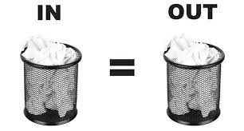
Where does the Netlist come from?
module CONTROL …
input A, B, C;
output reg X;
…..
if (A)
X = B | C;
else
X = B & C;
module CONTROL ….
input A, B, C;
output reg X;
…..
and2 U1 (.I0(B), .I1(C), .Z(T1);
or2 U2 (.I0(B), .I1(C), .Z(T2);
mux2 U3 (.S(A),.I1(T1),.I2(T2), .Z(X);
Logic Synthesis
(CDS Genus)
RTL Code
(Verilog / VHDL)
Gate-level Netlist
(Verilog / VHDL)
create_clock –period 10 ……
set_input_delay –max 1.2 ….
set_output_delay –max 2.5 ….
set_load 0.25 …..
……….
GIGO
Constraints

Slide 27
“Layout” vs. “Abstract” Views
A standard cell library also contains a corresponding abstract view for each layout view
Abstract views contain only the minimal data needed for Place & Route (usually output in LEF)
VDD
Metal Pins
GND

Slide 28
What is Layout Exchange Format (LEF) File?
Dimension or “bounding box”
Technology Section
LAYER m1
TYPE ROUTING ;
WIDTH 0.50 ;
END m1
LAYER via
TYPE cut ;
END via
MACRO NAND_1
FOREIGN NAND_1 0.00 0.00
ORIGIN 0.00 by 0.00 ;
SIZE 4.5 by 12.0 ;
SITE core ;
PIN A
DIRECTION input ;
PORT
LAYER m1 ;
RECT 6.4 10.0 6.8 10.4 ;
END
PIN Y
...
OBS
LAYER via ;
RECT …
RECT …
END NAND_1
VDD
A
B
Symmetry (X, Y, or 90 degrees)
Definition of Std Cell/Macro
Y
Pins
Direction
Layer
Form
NAND_1
Reference point (typical)
GND
X
Technology and Std. Cell/Macro LEFs can be separate files or the same!

Slide 29

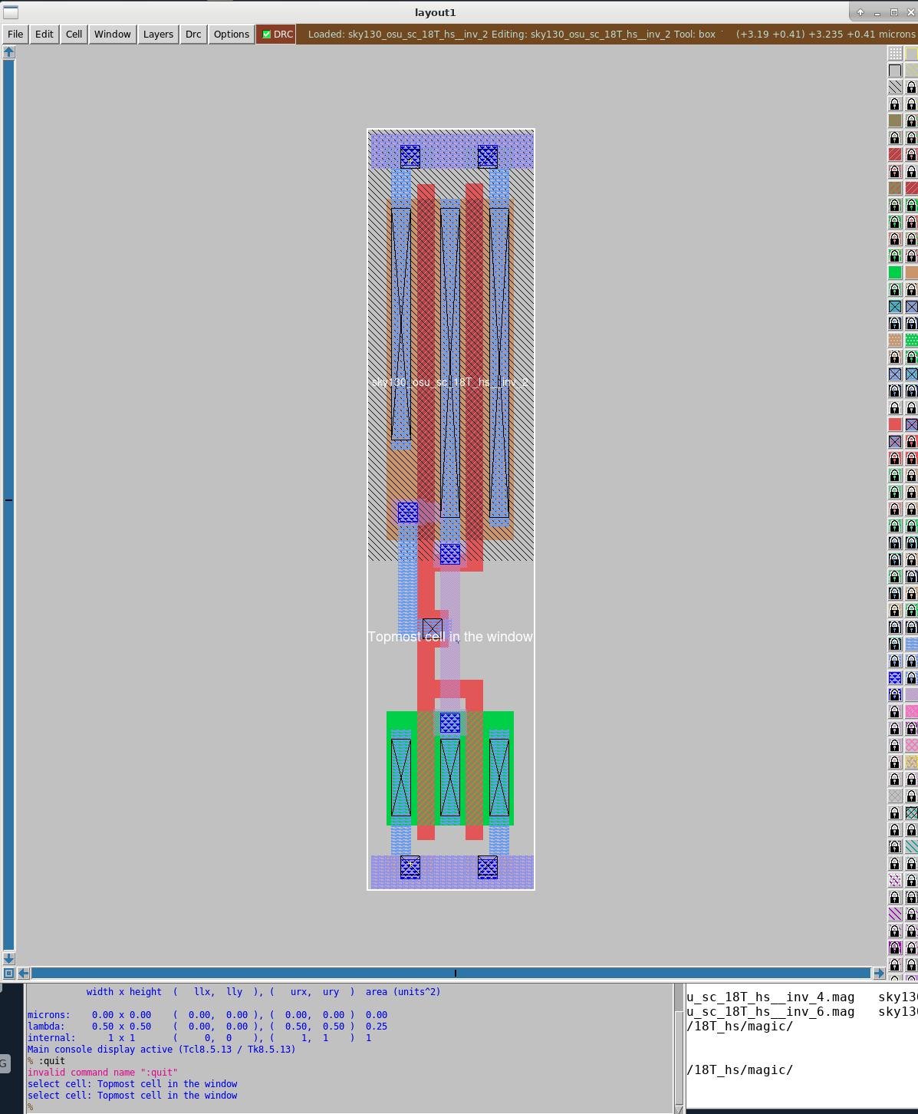
OSU SKY130 Standard Cells
The sky130_cds repository utilizes the Oklahoma State University standard cells to work with the Skywater Technology that was originally interfaced to open-source tools.
https://github.com/google/skywater-pdk
We integrated our standard-cell library as submodules into the repository and utilize the 18T variety of OSU cells.
This can be changed to use our other 12T and 15T cells by modifying the synthesis and place and route scripts.

Slide 30
What does “Place and Route” do?
Layout is built out of three types of reference cells:
Macro cells (ROMs, RAMs, IP blocks)
Standard cells (nand2, inv, dff, ...)
Pad cells (input, output, bi-dir, Vdd, Vss pads)
Macro and Pad cell locations are defined by you during the Floorplanning stage, before Placement and Routing
Location of all Standard Cells is automatically chosen by the tool during Placement, based on routability and timing
Pins are then physically connected during Routing, based on timing
RAM
IP
ROM
Place the cells
A2
Z
A1
Z
A
Z
Z
A2
OR2A3
INVA4
A1
A
Route wires between pins
OR2A3
INVA4
Abstract
Abstract

Slide 31
What is Placement+Optimization?
Gate-Level Netlist
Physical Optimization
IP
Logical Constraints
Floorplan
Companies typically buy products they don’t have expertise with and want guarantee of that function for their design → typically called Intellectual Property or IP.
Placement involves careful placement of parts/blocks.
IP
Placed & Optimized Design

Slide 32
Routing
Routing involves connecting all our nets together with some form of connection.
That is, how can we get all our nets from our synthesis netlist to output a netlist indicating an actual wire is routed between them.
This is a hard problem in that sometimes routing is not always possible, mainly due to floorplanning.
Hopefully, you can see that careful floorplanning is essential to this process!
This area is also critical for delay estimation and its intended Cost that is attributed to this factor.

Slide 33
Vias: Connecting Metal to Metal
Connecting between metal layers requires one or more vias.
Example:
Connecting a signal from Metal 1 to Metal 3 requires two vias and an intermediate Metal 2 connection.
Via23
Metal 3
Oxide
Metal 2
Oxide
Metal 1
Via12

Slide 34
Preferred Routing Directions
Metal layers have preferred routing directions
Default preferred direction:
Metal 1 – Horizontal
Metal 2 – Vertical
Metal 3 – Horizontal, etc
Why is this beneficial?

Slide 35
PnR’s main Challenge: Routing Blockages
CORE AREA
MACRO
Metal 2 Routing
Metal 3 blockage
Metal 3 blockage
Metal 2 blockage
Metal 2 blockage
Metal 3 blockage
Metal 3 Routing
MACRO

Slide 36
What do Electronic Design Automation (EDA) tools do?
module CONTROL ….
input A, B, C;
output reg X;
………..
and2 U1 (.I0(B), .I1(C), .Z(T1);
or2 U2 (.I0(B), .I1(C), .Z(T2);
mux2 U3 (.S(A),.I1(T1),.I2(T2), .Z(X);
………..
EDA Tool
IP
Gate-level or Datapath Netlist
P&R’d Layout
create_clock –period 10 ……
set_input_delay –max 1.2 ….
set_output_delay –max 2.5 ….
set_load 0.25 …..
……….
Custom-Cell
Timing Constraints
Standard Cell Library
36

Slide 37
Routing Operations
PnR performs:
Global Routing
Track Assignment
Detail Routing
Search and Repair
After global routing, track assignment and detail routing all clock/signal nets will be completely routed and should meet all timing, and most of the DRC requirements
Any remaining DRC violations can be fixed by Search&Repair
Global Route
Track Assign
Detail Route
Search&Repair

Slide 38
Global vs. Detailed Routing
Global routing
Input: detailed placement, with exact terminal locations
Determine “channel” (routing region) for each net
Objective: minimize area (congestion), and timing (approximate)
Detailed routing
Input: channels and approximate routing from the global routing phase
Determine the exact route and layers for each net
Objective: valid routing, minimize area (congestion), meet timing constraints
Additional objectives: min via, power

Slide 39
EDA PnR Basics
There are many ways that place and route works, but the basic is what we explained before.
We start with a netlist and get another netlist.
The process involves taking information related to the “physical” geometry and translating the netlist into this realization.
There are many software tools.
We use Cadence Design Systems innovus (used to be called Encounter Digital Implementation or EDI or SoC Encounter and previously Silicon Ensemble).

Slide 40
General innovus Design Flow
Synthesis
Design & Timing Setup
Floorplanning
Placement
CTS
Routing
Design for Manufacturing

Slide 41
Post-Layout Verification (don’t forget!!!)
After P&R the design must be functionally verified:
Goal: Reuse existing testbenches and stimulus files
P&R operates on a flat design
By default, output netlist is flat:
Test “probe” points on subblock boundaries may have moved or disappeared – cannot reuse testbench
Solution: Preserve the Hierarchy
This prevents P&R from making modifications to the interfaces of the subblocks (inversion, addition/removal of ports, etc.)
Backward movement of Design Flow

Slide 42
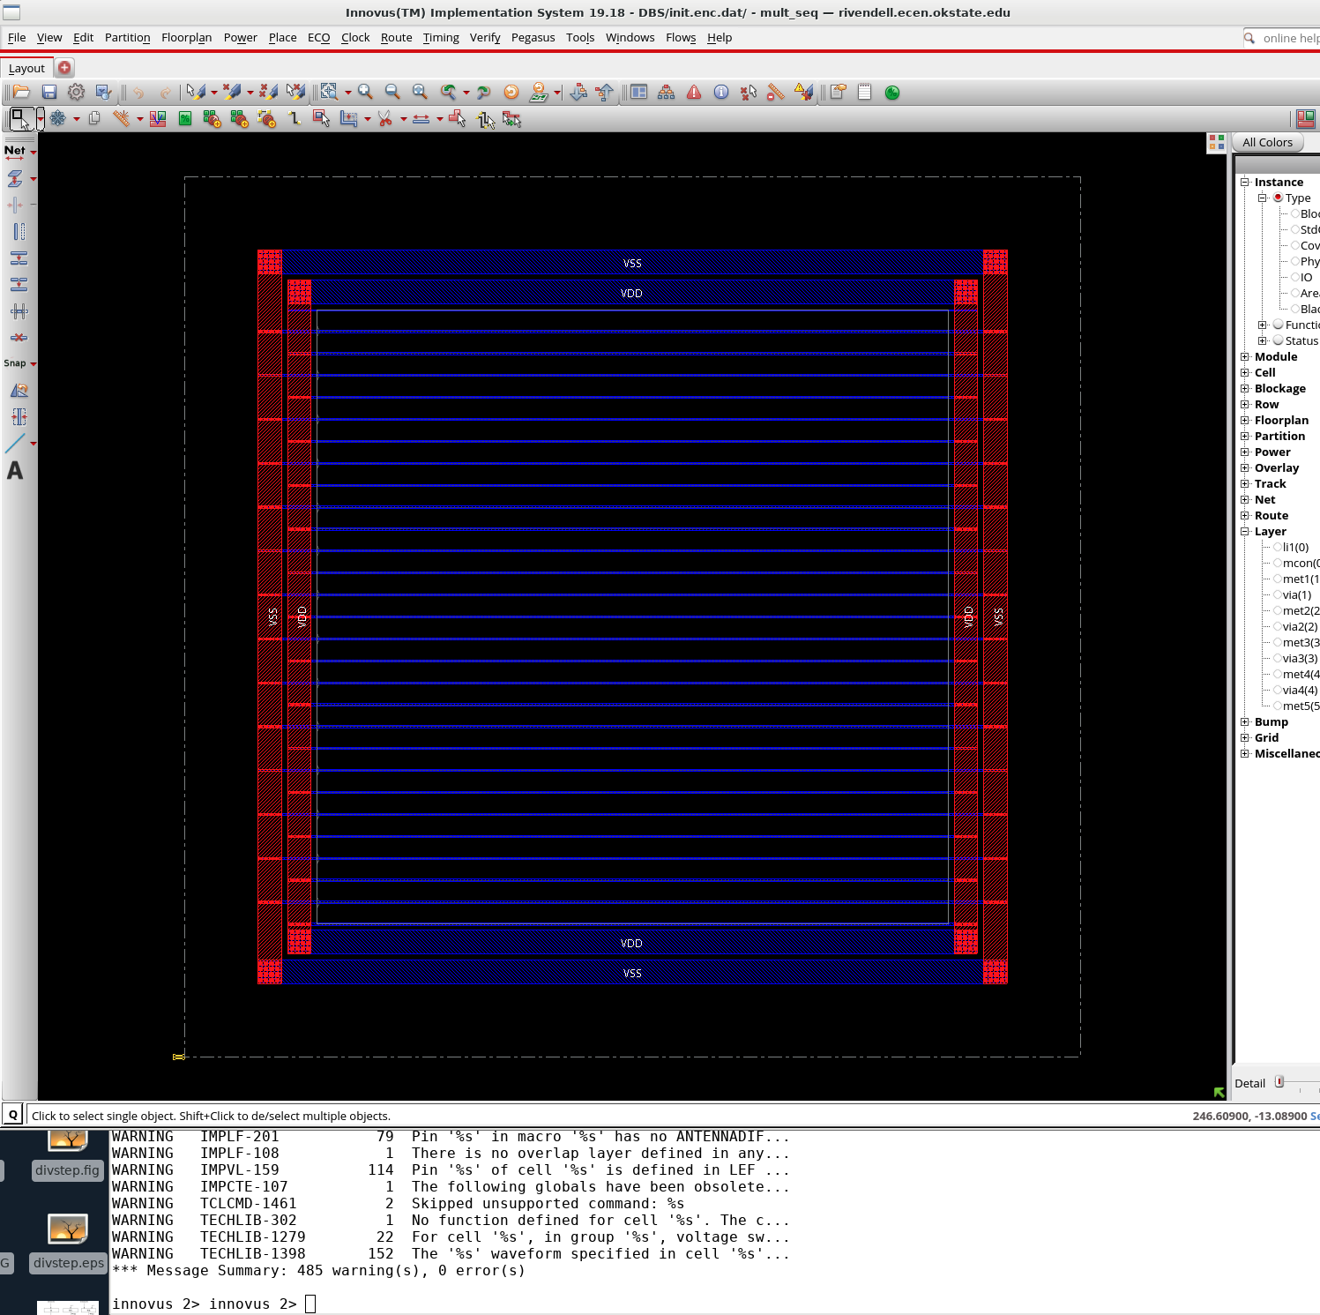
Innovus
Type innovus to run place and route tool.
Two windows appear : GUI and command line
You type your commands in the text window.
Innovus produces two files every time you type a command
.log: helps record what the screen said
.cmd: helps you remember what you typed to hopefully integrate into a script
Each log/cmd file have a suffix to differenate the times you opened innovus (e.g, innovus.cmd3)
This suffix will increment every time you open a new innovus window.

Slide 43
Innovus Foundation Flow Structure
Innovus has some basic elements to help integrate a design more effectively.
This is done through the Foundation Flow that Cadence integrated into Innovus.
It helps automate the scripts to work effectively for you by allowing easier edits on the vast array of Innovus commands.
The command references (HUGE document) is the best document to learn more about each command.
The Foundation Flow creates a Makefile with some key files:
setup.tcl – has information related to your design
innovus_config.tcl – information related to your SoC design such as filler and plugins.
It also creates some key directories
DBS – where you store each innovus run (e.g., place)
RPT – reports about your design
LOG – copies of the cmd/log after each step of the Foundation Flow (see next slide)
PLUG – contains plugins that help add extra commands before/after each step in the Foundation Flow
SCRIPTS - scripts for Foundation Flow (don’t touch, if possible)
TEMPLATES – templates for Foundation Flow
VARS – variables used by Foundation Flow (probably do not need to touch)

Slide 44
setup.tcl
To place/route a design, you need to modify some key elements of your setup.tcl
set vars(design) "mult_seq"
set vars(netlist) "$vars(data_root)/mult_seq.vh”
set vars(setup_func_mode,pre_cts_sdc) "$vars(data_root)/mult_seq.sdc”
The design is the name of your top-level module you synthesized in the synth directory
The netlist is the name of the ”mapped” netlist from your synthesis
The xxx_sdc is the name of the sdc produced by your synthesis that contains information about the design intent.
The SDC file is a Tcl file used to specify the design intent, including timing, power and area constraints for a given design.

Slide 45
Innovus Makefile
The Innovus Makefile has several steps setup to help check items at the end of each step
init – initialization stage (setups up power domain)
place - placement
cts - clock tree synthesis (required for clock-based designs)
postcts_hold – cts but check on hold timing
route - routing
postroute – postroute checks
Signoff – signoff steps
There are some other steps (e.g., setup) that create necessary directories but are not design specific.
Each step can be run by typing make route.
If a previous step is not run beforehand, it will run. For example, for route, steps 1-4 will be run if not run already.
All runs will save into the DBS directory for restoring and checking
Important: if you have a purely combinational design, you must remove the cts and postcts steps (steps 3 and 4) from the Makefile.

Slide 46
PLUGINS
Plugins are allowed to help carve your Foundation Flow scripts with additional items.
For example, suppose you want to add a power ring to your design, you can add to a step (e.g., post_init.tcl)
These plugins are found in the PLUG/INNOVUS directory and are all Tcl files (these files can be located anywhere but included in the PLUG subdirectory for convenience).
To use one of these plugins, uncomment them out of the innovus_config.tcl file and run your Foundation Flow step
Here’s an example of post_signoff.tcl that runs a Tcl file called tapeout.tcl (produces the gds file of your design)
##################################################################################
# POST-SIGNOFF PLUG-IN
##################################################################################
#
# This plug-in script is called after timeDesign -signoff from the run_signoff.tcl
# flow script.
#
##################################################################################
source tapeout.tcl

Slide 47

Post Innovus Runs
Any commands run through the pnr are in the LOG subdirectory. There is one file that lists the commands (i.e., cmd) and the other that lists output from the command or the log files (i.e., .log). Reports are found in the RPT subdirectory.
To pull up a placed-and-routed design from the route stage
start innovus and type: restoreDesign DBS/route.enc.dat mult_seq.
You can restore any step stored from the Foundation Flow if its inside the DBS directory
It is important that the last argument be the top-level design indicated in the setup.tcl file.

Slide 48
Important Tip
SoC design utilizes a complex plethora of Electronic Design Automation (EDA) tools.
Invariably, something goes wrong with the design flow or one of the EDA tools that may produce warnings that displayed on the screen too fast for a user to see.
A very important tip based on experience is to always inspect the log files that each EDA tool generates line by line.
Missing one warning or maybe error could lead to disastrous results later.

Slide 49

Design Rules Check (DRC)
Design Rules Check is an important part of the process for a SoC design.
Innovus utilizes Pegasus tool with hand-crafted rules for edge/vertices for the SKY130 process
You can run within Innovus by typing:
run_pegasus_drc sky130_drcRules.pvl -mapfile streamOut.map -stream_out -merge ../sky130_osu_sc_t18/18T_ms/gds/*.gds.
The merge option is used to merge the standard cell gds files with the gds of the design.
Output
Log files can be seen the specified run directory.
Error markers can be seen in mult_seq.pegasus.ascii and the drc run summary in mult_seq.pegasus.sum.

Slide 50
Parasitic Extraction (PeX)
Parasitic Extraction (PeX) is important in creating information about the resistances and capacitances associated with a design.
PeX is handled by Quantus and similar to Pegasus can be run through Innovus
Edit the setup.tcl to add the qrcTechfile. The qrcTechfile is generated by simulating the ict file provided by the foundry using Techgen.
Edit innovus_config.tcl to set the effort level for RC extraction. It is set to medium right now.
make
Results can be seen in rc_typ.spef by default.
To run extraction from Innovus command prompt and see the output files at a different location:
setExtractRCMode -engine postRoute -effortLevel <specify the effort level>
extractRC
rcOut -spef SPEF/mult_seq.spef → this stores the spef files in the specified SPEF directory with a file called mult_seq.spef.
If no qrcTechfile is specified, RC extraction is done only at effort level ‘low’.

